Slide 1
THE ACFE LIFECYCLE

Slide 2
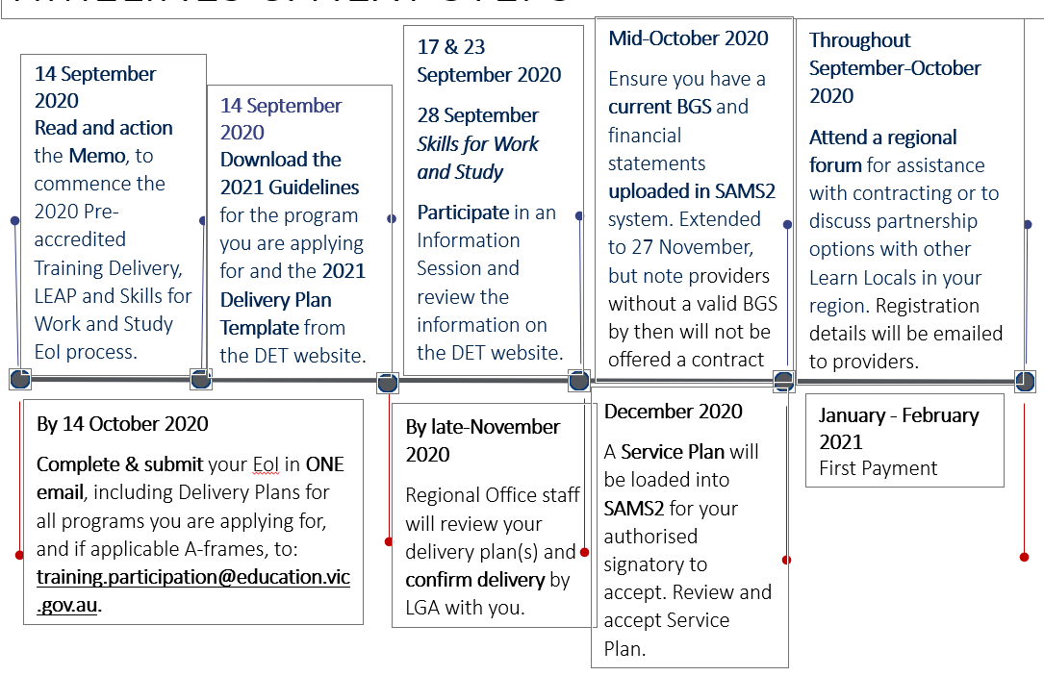
Key Dates (2020):

Slide 3
Documents required for EOI:
1. Pre-accredited Delivery Plan Template – yes that is the hideous spreadsheet that goes for miles. Apply for up to a maximum of your previous years allocation.
HINT: Always list the modules you want to deliver in order of preference. If you don’t get all the hours you ask for, theoretically the Dept will drop off modules from the end of the plan.
2. Prepare the Course plans for all existing pre-accredited modules.
3. Prepare a full A-Frame including Course Plans and Session Plans for any new or substantially amended modules.

Slide 4
Other types of funding available:
LEAP Programs:
LEAP is a distinct and separate program from pre-accredited training delivery, in its particular focus on engagement.
LEAP programs are minimum 5 hours and maximum 19 hours in duration. (keep in mind they come with the same amount of paperwork and compliance with the exception of Session Plans)
Skills for Work and Study (new in 2021):
There are 7 industry-contextualised programs with all curriculum documentation available.

Slide 5
Other types of funding available:
Training Delivery Support Grant:
$5500 paid to all providers with a current contract.
Comes out in January, must be spent by December 31 of that year
A Purchase Plan template must be completed and forwarded to your Region stating the proposed items to be purchased, reason for purchase and estimated cost
Things like your SMS licence or equipment required to administer your ACFE contract are acceptable.

Slide 6
Lodging your EOI
Note: You must submit ONE email which includes all Delivery Plans and if applicable, A-frames for all programs you are applying for. You may need to zip the files. If you cannot fit all documents, please ensure that all Delivery Plans are in one email. Once submitted to the training participation inbox, you will receive an acknowledgement of submission. If you do not receive an acknowledgement within one week, please contact the Department.

Slide 7
Payment & upload schedule
Payment and Reporting Schedule This schedule applies to Pre-accredited Training, Learner Engagement A-frame Program (LEAP) and Skills for Work and Study. Pre-accredited training programs | Victorian Government (www.vic.gov.au)
No. | Payment Processing date | Payment percentage (%) | Cumulative payments percentage (%) | Requirement for release of payment
1 | January/February | 35% | 35% | Contract execution
2 | April | 25% | 60% | 25% enrolments reported by 30 Mar 21
3 | August | 20% | 80% | 55% enrolments reported by 31 Jul 21
4 | October | 20% | 100% | 75% enrolments reported by 30 Sep 21
By January 15 each year the final upload of student data from the previous year must be done. If there is an under-delivery of hours in this upload you will be required to pay back funds equivalent to $9.10 x the number of undelivered hours.

Slide 8
The SACC
The SACC is your Service Agreement Compliance Certification
The SACC consists of a series of questions to be completed annually by the funded organisations, which certifies compliance with Service Agreement requirements. The questions relate to:
financial management - that the organisation has used funding as outlined in their Service Agreement, is financially viable, has prepared its financial reports and any audit reports and maintains an asset register
risk management - that risks are managed in accordance with the Australian/New Zealand Risk Management Standard
staff safety screening - that referee checks, police record checks and, if relevant, Working with Children Checks have been completed
privacy - that the organisation’s practices and systems are compliant with the Privacy and Data Protection Act 2014 and the Health Records Act 2001 to protect personal and health information
ACFE Board Business and Governance Status (BGS) - the organisation has submitted an up-to-date BGS assessment or is eligible for an exemption to the BGS requirement under the Business and governance status assessment guidelines.

Slide 9
The BGS
The Business Governance Statement
“Organisations registered or wishing to register with the ACFE Board must pass the BGS assessment to demonstrate their business / governance arrangements and performance that support their suitability to apply for government funding”
There is a template downloadable from the Dept website for the BGS.
Have your auditor complete the BGS when your annual financial audit is completed
NOTE: RTO’s are exempt from completing the BGS

Slide 10
Completing the SACC
The SACC notifications will be emailed to your organisation via SAMS2 and is due 90 days after the end of your organisation's reporting period. However, if your organisation's annual general meeting (AGM) is after the due date you can insert your organisation's AGM date in SAMS2 and the SACC due date will automatically update to seven days after the AGM.
Organisations should ensure the Contacts tab in SAMS2 is updated regularly to avoid delays in this process.
The SACC will need to be completed in My Agency, the secure area of the Funded Agency Channel (FAC) website, where organisations update records and information regarding their funded services.
Within My Agency, registered users will enter the Service Agreement Module (SAM) and be required to complete and submit their organisation's Service Agreement Compliance Certification (SACC).
The SACC can be saved at any time, allowing for different areas of your organisation to individually complete different sections.
Once completed, the SACC should be submitted by an authorised person, such as the Director, Chairperson, Chief Executive Officer, President, Principal or Treasurer.
Further information about how to complete the SACC Form is available on the DHHS website.
The BGS is uploaded as part of the SACC

Slide 11
Completing the SACC - The Funded Agency Channel – aka SAMS2
You will be notified by email when your SACC is due.
It is completed inside SAMS2
(If you have never experienced SAMS2 then you are in for a treat. It is a fresh new hell of 1980’s computer programming at its very best)
You have 90 days after the end of your financial year to complete it.
There are details on how to navigate SAMS2 to complete your SACC on the Dept website.

Slide 12
The Funded Agency Channel – aka SAMS2
You will be notified by email regarding your Delivery Plan assessment and your approved funding outcome in late November
The executed Service Agreement will be sent to your organisation’s signatory via SAMS2. Your signatory must logon to SAMS2 to review and accept the Service Plan.
(If you have never experienced SAMS2 then you are in for a treat. It is a fresh new hell of 1980’s computer programming at its very best)
SAMS2 is where you will also find details of your NHCP funding and payment cycles

Slide 13
Links to key documents
ACFE Board Business and Governance Status (BGS) Business and governance status assessment guidelines.
The SACC will need to be completed in My Agency, the secure area of the Funded Agency Channel (FAC) website
Further information about how to complete the SACC Form is available on the DHHS website
ACFE Provider Registration Guidelines https://www.vic.gov.au/become-registered-learn-local-provider
2021 pre-accredited Training Delivery guidelines https://www.vic.gov.au/pre-accredited-training-and-programs
Data reporting guideline: https://www.education.vic.gov.au/Documents/training/providers/learnlocal/grants/2021%20Pre-accredited%20Training%20Data%20Reporting%20Guidelines%20(22Mar21).docx

